Slide 1
Shares

Slide 2
Buying and selling shares?
Notes:
http://australianinvestmenteducation.com.au/articles/how-to-buy-shares-in-the-stock-market/

Slide 3
Why buy shares?
Making money for living
Investment for retirement
How to make money from shares?
Buy the share at a low price and sell it at a high price (generally short term)
Dividend given by the company.
Capital gains - buy the share at a price, keep the shares for a long time and wait for the value of the share price to increase.

Slide 4
Dividend
Company which made some profits may choose to distribute the profits among the shareholders.
May not happen every year – it depends on the amount made.
The company director may not want to share the profits because they want to expand the company or re-invest the money.

Slide 5
Portfolio
All the shares an investor own.
Can calculate the total value of the share based on the share price.
Worksheet.

Slide 6
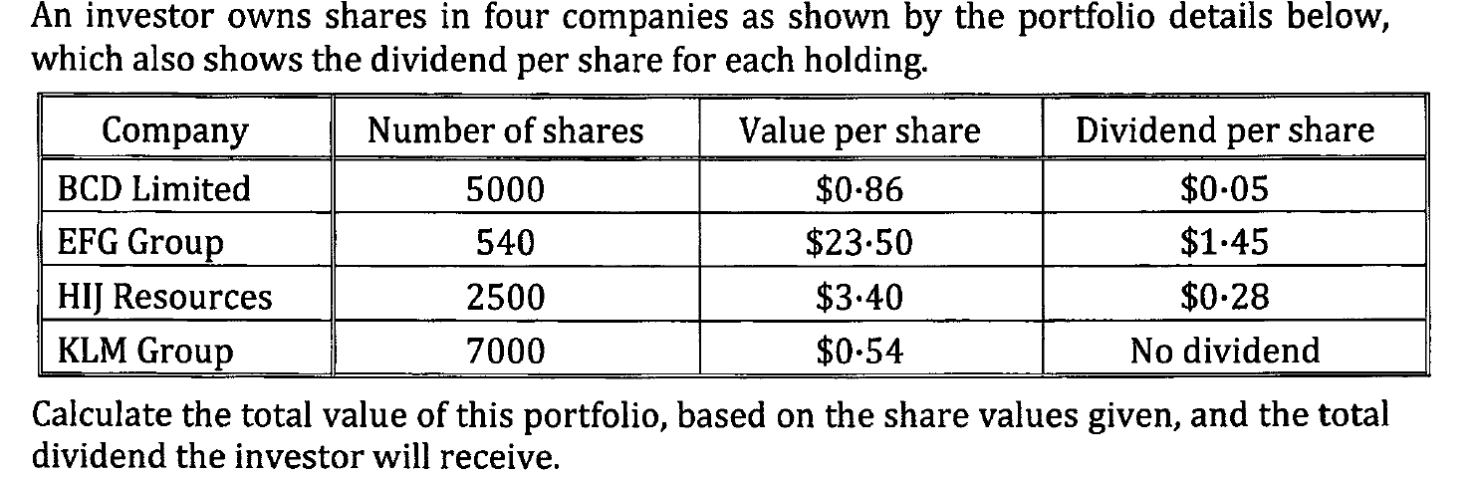

Slide 7
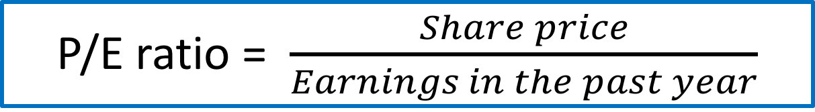
Price to earning ratio (P/E ratio)
P/E ratio = $\frac{Share price}{Earnings in the past year}$
Earnings in the past year = dividend in the last 12 months.
How many dollars worth of share value we must pay to get one dollar of earnings in the year or the number of years it will take for the dividend to pay for the share.

